Slide 1

Computer Networks (CET2005B)
School of Computer Engineering and Technology (SCET)

Slide 2

Computer Networks
Teaching Scheme Credits: 3 + 1 = 4
Theory: 3 Hrs / Week Practical: 2 Hrs / Week
Course Objectives:
1. Knowledge:
i. To understand the fundamentals of networking and data communications.
ii. To understand network & data link layer protocols.
2. Skills: i. To learn network layer protocols.
3. Attitude:
i. To explore services offered by the transport layer.
ii. To understand protocols of the application layer
Course Outcomes:
On completion of course, students should be able to
1. Identify characterizing features of transmission techniques.
2. Recall and Demonstrate working of flow control & error control protocols.
3. Select routing protocol to Develop fully-functional simulation to simulate its working.
4. Define connection oriented & connectionless transport layer protocols & build working applications based on it.
5. Choose application layer protocol and make use of it in a suitable environment.

Slide 3
Pre-requisites
- Programming and Problem Solving

Slide 4
Syllabus
1 | Fundamentals of networking and data communication (9 Hrs) Analog Transmission: Analog-to-Analog conversion, Digital-to-Analog conversion, Digital Transmission: Digital-to-Digital conversion (line coding, block coding, scrambling), Analog-to-Digital conversion (Pulse Code Modulation, Delta Modulation) Types of Networks, Network Architectures, Network Topologies, Transmission media’s, Networking devices, OSI Model, TCP/IP Reference Model, Ethernet standards.
2 | Data Link Layer: (9 Hrs) Data Link Layer Services, Types of errors, Block coding, Error Control: Cyclic Redundancy Check (CRC) Code, Hamming Code, Checksum, sliding window Protocols: Selective Repeat (SR) & Go Back N (GBN), Channel allocation, Multiple Access Protocols: ALOHA, CSMA/CD, CSMA/CA, Ethernet Frame format.
3 | Network Layer (9 Hrs) Services, Internet Protocol: Ipv4 & Ipv6, Classful Addressing, Classless Addressing, CIDR, Subnetting, NAT, ARP, RARP ICMP, Routing Algorithms: Distance-Vector (DV) Routing, Link State (LS) Routing, Routing in Internet: RIP, OSPF, BGP
4 | Transport Layer (9 Hrs) Services, Multiplexing, demultiplexing. Sockets, UDP, RTP, TCP: Services, Features, Segment, TCP Connection (Three-Way Handshake), Flow control and buffering, Silly window syndrome, Congestion Control. Congestion Control (Leaky Bucket, Token Bucket), Quality of Service (QoS)
5 | Application Layer (9 Hrs) Dynamic Host Control Protocol (DHCP), Hypertext Transfer Protocol (HTTP), FTP, TELNET, SMTP: POP3, IMAP, MIME, Domain Name System (DNS), SNMP.

Slide 5
Guidelines for CCA and LCA
Examination Scheme
CCA Marks Distribution
Sr. No. | Examination Scheme | Marks
1. | Class Continuous Assessment (CCA) | 30
2. | Laboratory Continuous Assessment (LCA) | 30
3. | Term End Examination | 40
Sr. No. | Class Continuous Assessment: (30 Marks) | Marks
1. | Mid Term Exam | 15
2. | Active Learning | 10
3. | Component | 05
Sr. No. | Laboratory Continuous Assessment: (30 Marks) | Marks
1. | Practical Performance | 10
2. | Implementation | 10
3. | End Term Practical/ Oral Examination | 10

Slide 6
Lab Assignment
Design a simple network (LAN) with different topologies & test it using PING utility.
Analyze and test PCM modulation technique.
Design and configure a virtual LAN.
Write a program for error detection and correction codes using Hamming Codes
Write a program to implement subnetting to find subnet mask
Implement Static and Dynamic NAT Configuration with Packet Tracer
Set up a network - configure interfaces, IP addresses and routing protocols (RIP, OSPF, EIGRP, BGP).
Write a C program for wired network using TCP socket to demonstrate a) Chat Application (50% Students) b) Mathematical operations. (Remaining 50% Students) Show packet captured traces using Wireshark Packet Analyzer Tool.
UDP Socket Programming: (Language: C/C++/Python/Java)/ Write a C program for wired network using UDP socket to perform any one of the following operations.
a. String Conversion from UpperCase to LowerCase. (50% Students)
b. Reverse the String. (Remaining 50% Students) Show packet captured traces using Wireshark Packet Analyzer Tool.
Configure network using Dynamic Host Configuration Protocol (DHCP), DNA and Web server Use Ping utility to
test connectivity.

Slide 7
Unit I: Fundamentals of networking and data communication
Analog Transmission: Analog-to-Analog conversion, Digital-to-Analog conversion, Digital Transmission: Digital-to-Digital
conversion (line coding, block coding, scrambling), Analog-to Digital conversion (Pulse Code Modulation, Delta Modulation)
Types of Networks, Network Architectures, Network Topologies,
Transmission media’s, Networking devices, OSI Model, TCP/IP
Reference Model, Ethernet standards.

Slide 8
Learning Resources:
Text Books:
1. Behrouz A. Forouzan, ‘Data Communications and Networking’, 5th Edition, McGrawHill Publishing Company,
ISBN 978-0-07-337622-6
2. Tanenbaum A. S., ‘Computer Networks’, Pearson Education, 5th Edition, ISBN-978-0-13-212695-3
Reference Books:
1. James F. Kurose and Keith W Ross ‘Computer Networking, A Top-Down Approach’, 5th Edition, Pearson
Education, ISBN- 978-81-317-9054-0
2. W. Richard Stevens, Unix Network Programming, The Sockets Networking API, Vol 1, 3rd Edition, PHI
Learning Pvt. Ltd.
Supplementary Reading:
1. William Stallings, ‘Data and Computer Communications’, 6th Edition, Prentice Hall of India Pvt.

Slide 9
Introduction
Data Communications Telecommunication – means communication at a distance. (“tele”, greek word for “far”)
Data - refers to information presented in whatever form is agreed upon by the parties creating and using the data
Data Communication - exchange of data between two devices via some form of transmission medium such as a wire cable
Data is a collection of facts. Information is how you understand those facts in context
Data is unorganized, while information is structured or organized
Data is not typically useful on its own, but information is
Information depends on data

Slide 10
Analog and Digital Data
The term analog data refers to information that is continuous
Analog data, such as the sounds made by a human voice, take on continuous values can be captured by a microphone and converted to an analog signal or sampled and converted to a digital signal
Digital data refers to information that has discrete states
Digital data take on discrete values. For example, data are stored in the memory as 0s and 1
They can be converted to a digital signal or modulated into an analog signal for transmission across a medium

Slide 11
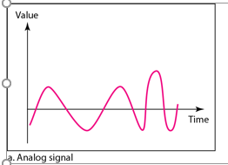
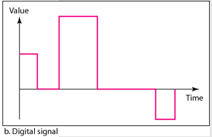
Analog and Digital Signals
Signal - A signal is an electromagnetic or electrical current that is used for carrying data from one system or network to another
An analog signal is any continuous signal for which the time varying feature of the signal is a representation of some other time varying quantity i.e., analogous to another time varying signal.
A digital signal is a signal that represents data as a sequence of discrete values; at any given time it can only take on one of a finite number of values. Discrete value 1 and 0

Slide 12
Difference between Analog and Digital Signals
Analog Signals | Digital Signals
Analog signal is continuous and time varying. | Digital signal have two or more states and in binary form.
Troubleshooting of analog signals are difficult. | Troubleshooting of digital signals are easy.
An analog signal is usually in the form of sine wave. | An digital signal is usually in the form of square wave.
Easily affected by the noise. | These are stable and less prone to noise.
Analog signals use continuous values to represent the data. | Digital signals use discrete values to represent the data.
Accuracy of the analog signals may be affected by noise. | Accuracy of the digital signals are immune from the noise.
Analog signals may be affected during data transmission. | Digital signals are not affacted during data transmission.
Analog signals use more power. | Digital signals use less power.
Examples: Human voice, natural sound, Audio signal, Radio signal etc. | Examples: Computers, optical drives, etc.
Components like resistors, Capacitors, Inductors, Diodes are used in analog circuits. | Components like transistors, logic gates, and micro-controllers are used in Digital circuits.

Slide 13
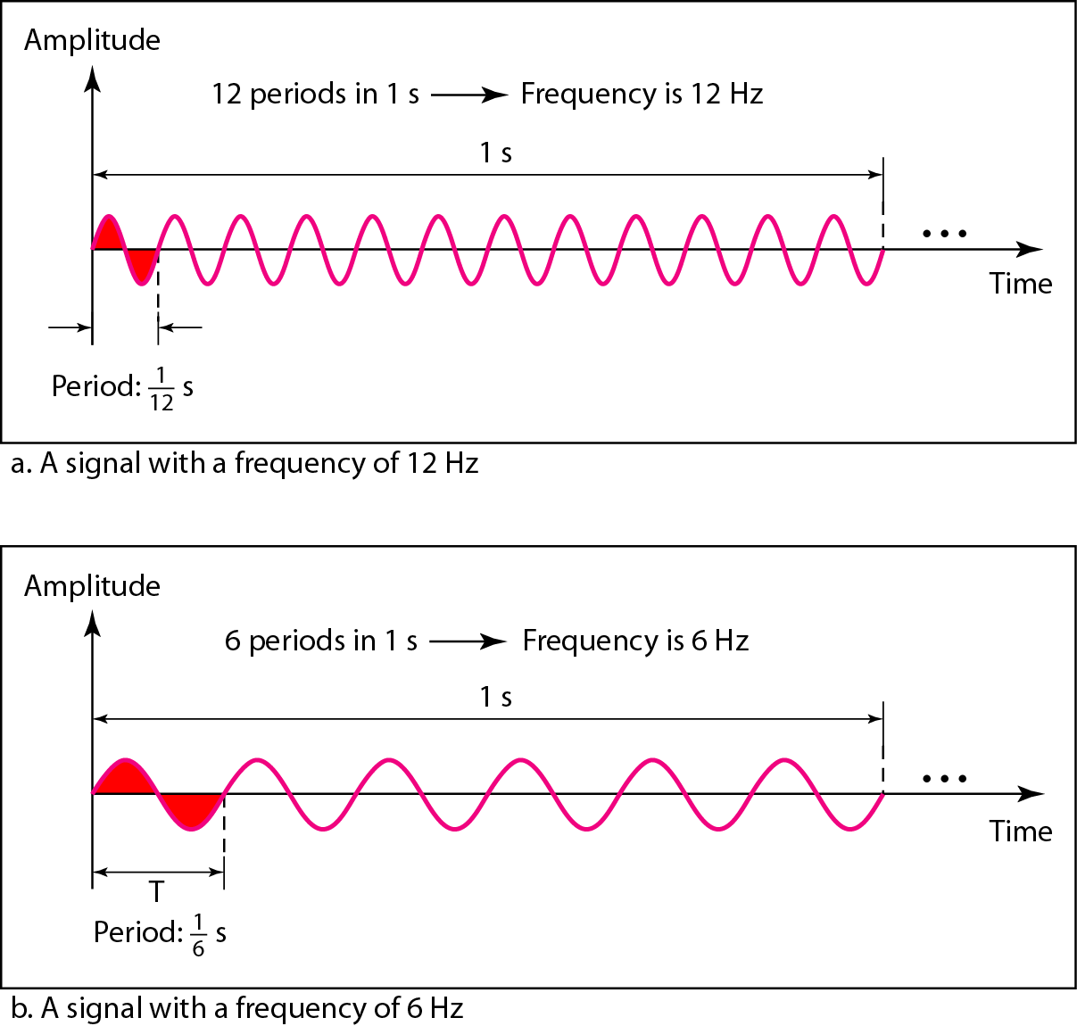
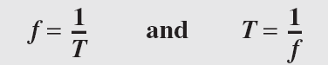
Period and Frequencies
Period refers to the amount of time, in seconds, a signal needs to complete 1 cycle.
Frequency refers to the number of periods in 1 s
Frequency and period are the inverse of each other.

Slide 14
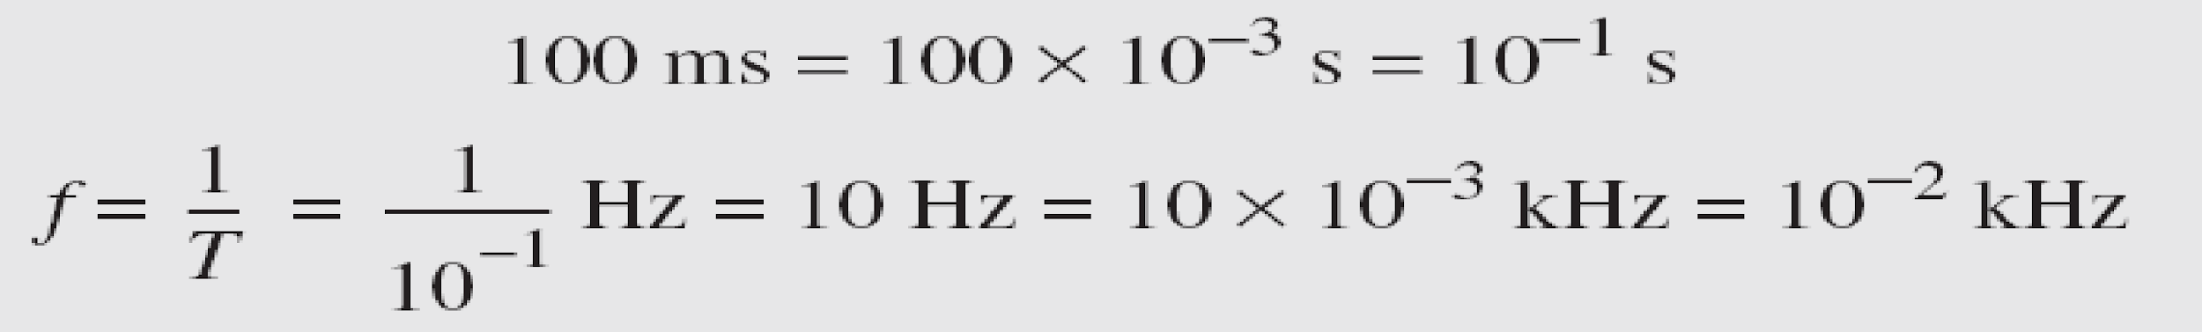
Period and Frequencies
Example 1. The power we use at home has a frequency of 60 Hz. The period of this sine wave can be determined as follows:
Example 2. The period of a signal is 100 ms. What is its frequency in kilohertz?
Solution
First we change 100 ms to seconds, and then we calculate the frequency from the period (1 Hz = 10⁻³ kHz).

Slide 15
Modulation
Modulation is the process of altering one or more properties of a periodic waveform known as a carrier signal with respect to the modulation signal, which contains information to be transmitted
Modulation is performed by the device known as a modulator, and this technique is mainly used to overcome the interference of the signal. Modulation techniques typically aid in long-distance communication
Modulation is of two types
1. Analog Modulation
2. Digital modulation

Slide 16
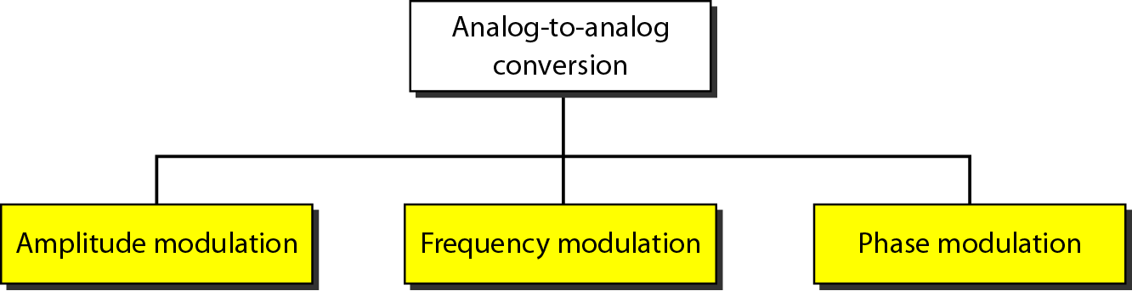
Types of Analog-to-Analog modulation
Amplitude Modulation: Amplitude is varied keeping frequency and phase constant
Frequency Modulation: Frequency is varied keeping amplitude and phase constant
Phase Modulation: Phase is varied keeping amplitude and frequency constant

Slide 17
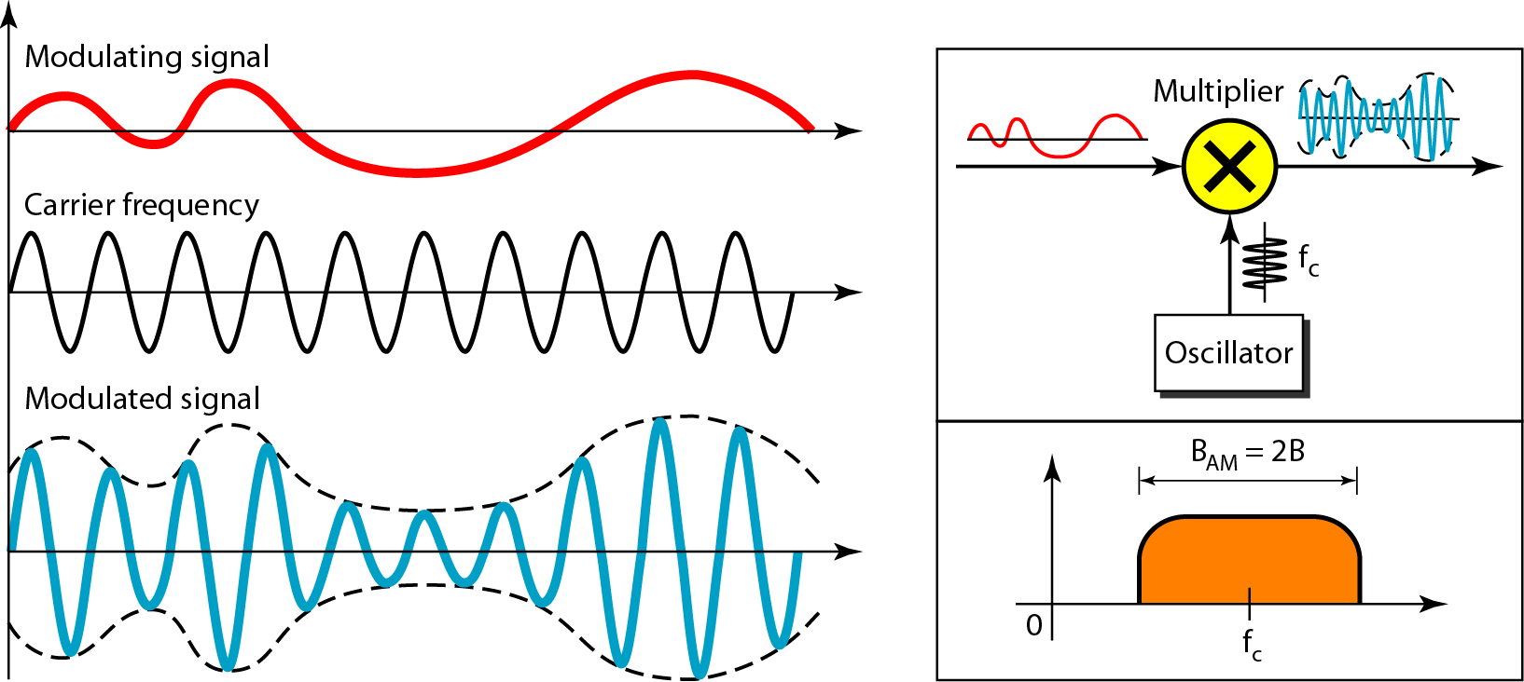
Amplitude Modulation
Amplitude is varied keeping frequency and phase constant
An oscillator is a circuit which produces a continuous, repeated, alternating waveform without any input.
The total bandwidth required for AM can be determined from the bandwidth of the audio signal: B_{AM} = 2B.

Slide 18
Advantages and disadvantages of AM
Advantages of Amplitude Modulation
Amplitude Modulation is easier to implement
The components used in building the AM transmitter and AM receiver are very cheap
It can be demodulated using a circuit consisting of very few components
Disadvantages of Amplitude Modulation
Poor Performance due to noise
Inefficient use of transmitter power
It is not efficient in terms of its use of bandwidth, requiring a bandwidth equal to twice that of the highest frequency.
Applications of Amplitude Modulation
Broadcast Transmissions
Air-band radio
Single sideband
Quadrature amplitude modulation

Slide 19
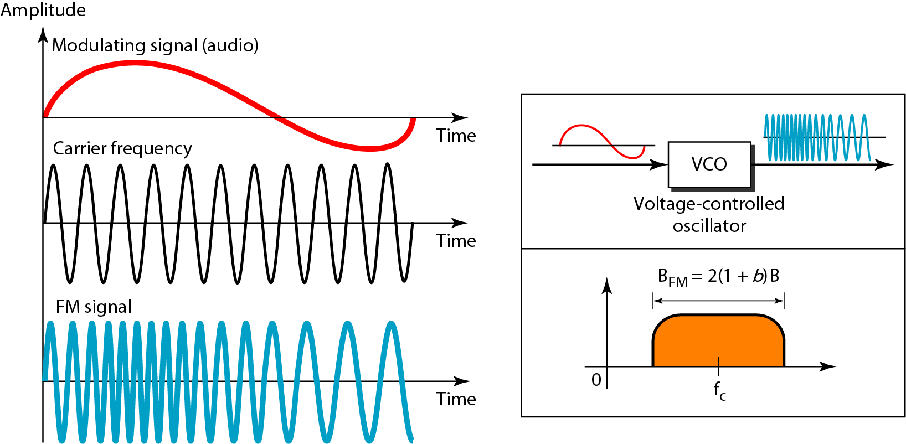
Frequency Modulation
Frequency modulation is the process by which the frequency of a carrier signal changes with respect to the modulating signal.
The total bandwidth required for FM can be determined from the bandwidth of the audio signal: B_{FM} = 2(1 + β)B. Where β is a factor depends on modulation technique with a common value 4.

Slide 20
Advantages and disadvantages of FM
Advantages of Frequency Modulation
The amplitude of the frequency-modulated wave does not get affected.
Large decrease in noise, hence increase in the signal to noise ratio.
Noise may reduce by increasing the frequency deviation.
Frequency allocation allows for a guard band which reduces adjacent channel interference.
It operates in a very high frequency called VHF.
Disadvantages of Frequency Modulation
FM cannot cover large areas.
Transmitting and receiving equipment of frequency modulation is complex and expensive.
A much wider channel tytpically 200 kHz is required by FM..
The antennas for FM need to be closely placed for better signals.
Applications of Frequency Modulation
Telemetry, radar and seismic prospecting, EEG monitoring
It is used in radio broadcasts
It is used for audio frequency synthesis.

Slide 21
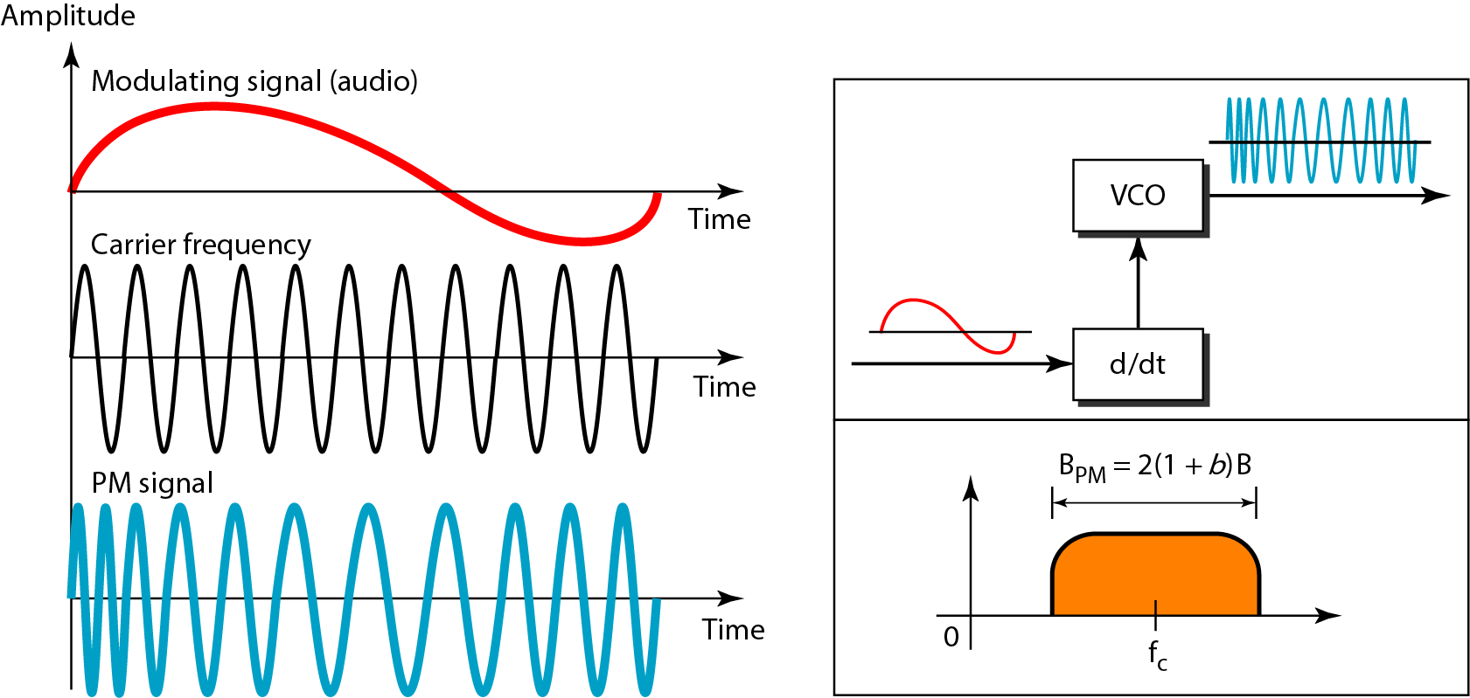
Phase Modulation
In PM transmission, the phase of the carrier signal is modulated to follow the changing voltage level (amplitude) of the modulating signal. The peak amplitude and frequency of the carrier signal remain constant, but as the amplitude of the information signal changes, the phase of the carrier changes correspondingly.
In PM the instantaneous change in the carrier frequency is proportional to the derivative of the amplitude of the modulating signal. The total bandwidth required for PM can be determined from the bandwidth and maximum amplitude of the modulating signal: BPM = 2(1 + β)B. The value of β is lower in the case of PM.

Slide 22
Advantages and disadvantages of Phase Modulation
Advantages of Phase Modulation
Phase modulation (PM) is a simple contrasted to Frequency modulation (FM)
It has a higher transmitter efficiency.
It has a higher noise immunity.
Disadvantages of Phase Modulation
The system cost is quite expensive
Phase ambiguity comes if we exceed its modulation index pi radian(180 degree).
we need frequency multiplier to increase phase modulation index.
Applications of Phase Modulation
Wireless technologies such as GSM, Satellite television, and Wi-Fi.
widely used in the transmission of radio waves satellite transmission system
Used in digital synthesizers for generating waveform and signal

Slide 23
Comparision of AM and FM
Amplitude Modulation | Frequency Modulation
In amplitude modulation, the frequency and phase remain the same | In frequency modulation amplitude and phase remain the same
Its modulation index varies from 0 to 1 | Its modulation index is always greater than one
It has only two sidebands | It has an infinite number of sidebands
It has simple circuit | It has complex circuit
The amplitude of the carrier wave is modified in order to send the data or information | The frequency of the carrier wave is modified in order to send the data or information
It requires low bandwidth in the range of 10 kHz | It requires high bandwidth in the range of 200 kHz
In AM received signal is of low quality | In FM received signal is of high quality
It operates in the medium frequency (MF) and high frequency (HF) | It operates in the very high frequency
It has poor sound quality | It has better sound quality

Slide 24
Digital-to-Analog conversion

Slide 25
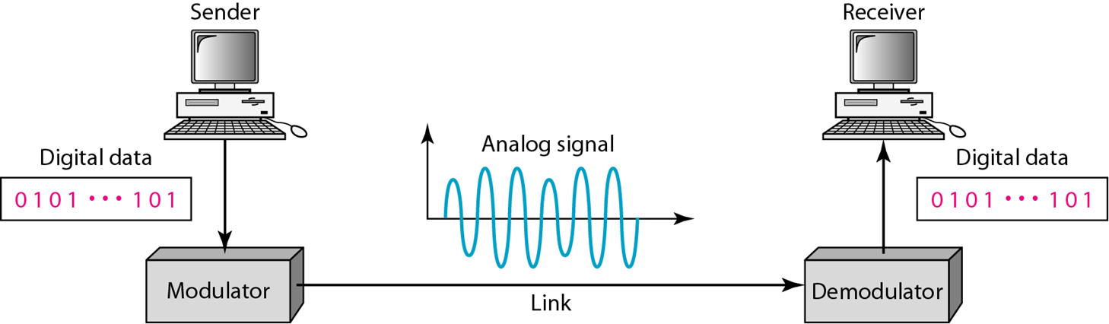
Digital-to-Analog conversion
Digital-to-analog conversion is the process of changing one of the characteristics of an analog signal based on the information in digital data

Slide 26
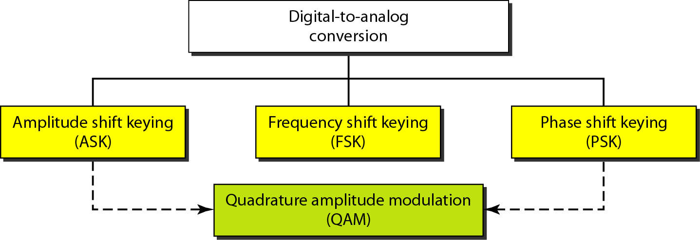
Types of digital-to-analog conversion
In amplitude shift keying (ASK), amplitude of a carrier is changed using the digital data.
In Frequency shift keying (FSK), the frequency of a carrier is changed using the digital data.
In phase shift keying (PSK), the phase of a carrier signal is changed to represent digital data.
In quadrature amplitude modulation (QAM), both amplitude and phase of a carrier signal are changed to represent digital data

Slide 27
Data Rate(Bit Rate) and Signal Rate(Baud Rate)
Bit rate (data rate) is the number of bits per second
Baud rate (signal rate) is the number of signal elements per second.
In the analog transmission of digital data, the baud rate is less than or equal to the bit rate
The relationship between data rate and baud rate is given by following formula
S= N * (1/r) baud
Where N is the data rate(bps) and r is the number of data elements carried in one signal element. The value of r in analog transmission is r=log₂L, where L is type of signal element

Slide 28
Data Rate Versus Signal Rate
Bit Rate | Baud Rate
The number of bits per second is known as the bit rate. | The number of signal units per second is known as the baud rate.
Bit rate determines the number of bits travelled per second. | Baud Rate determines the number of times a signal's status changes.
Bit rate= baud rate x the count of bits per signal unit. | Baud rate= bit rate/ the number of bits per signal unit.
The focus is on computer efficiency. | On the other hand, data transmission over the channel is more concerned.
Bit Rate cannot determine the bandwidth. | It can determine the amount of bandwidth necessary to send the signal.

Slide 29
Example 3
An analog signal carries 4 bits per signal element. If 1000 signal elements are sent per second, find the bit rate.
Solution
In this case, r = 4, S = 1000 (signal rate, or baud), and N (the bit rate) is unknown. We can find the value of N from

Slide 30
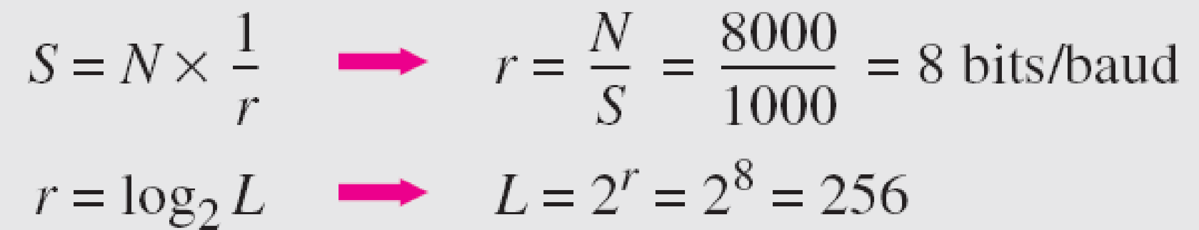
Example 4
An analog signal has a bit rate of 8000 bps and a baud rate of 1000 baud. How many data elements are carried by each signal element? How many signal elements do we need?
Solution
In this example, S = 1000 baud, N = 8000bps, and r and L are unknown. We find first the value of r and then the value of L.

Slide 31
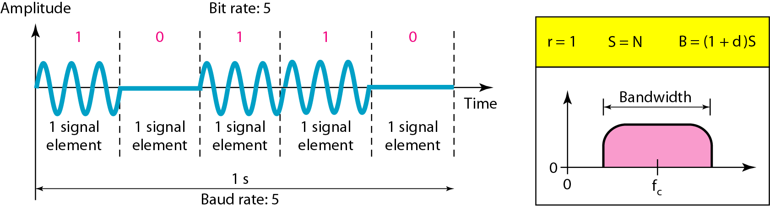
Amplitude Shift Keying (ASK)
In amplitude shift keying, the amplitude of the carrier signal is varied to create signal elements. Both frequency and phase remain constant while the amplitude changes.
ASK is normally implemented using only two levels. This is referred to as binary amplitude shift keying or on-off keying (OOK). The peak amplitude of one signal level is 0; the other is the same as the amplitude of the carrier frequency

Slide 32
Bandwidth of Amplitude Shift Keying (ASK)
Carrier signal is only sine wave, the process of modulation produces a non periodic composite signal.
Bandwidth is proportional to signal rate(baud rate).
There is another factor involved called as d, which depends on modulation and filtering process. The value of d is between 0 and 1.
Bandwidth can be expressed as shown
B= (1+d) * S
Where B is the bandwidth and S is the signal rate.
The middle of bandwidth is fc where carrier frequency is located.

Slide 33
Example 5
We have an available bandwidth of 100 kHz which spans from 200 to 300 kHz. What are the carrier frequency and the bit rate (N) if we modulated our data by using ASK with d = 1?
Solution
The middle of the bandwidth is located at 250 kHz. This means that our carrier frequency can be at f_{c} = 250 kHz. We can use the formula for bandwidth to find the bit rate (with d = 1 and r = 1).
Bandwidth = (1+d) * baud rate S
Don’t want to know baud rate S, we want to know bit rate N, so substitute S = N * 1/r
Bandwidth = (1+d) * N * 1/r
100kHz = 2 N * 1/1 (given r=1 and d=1)
100kHz = 2N
N = 50 kbps

Slide 34
Amplitude Shift Keying (ASK)
Advantages
It can be used to transmit digital data over optical fiber.
The receiver and transmitter have a simple design which also makes it comparatively inexpensive.
It uses lesser bandwidth as compared to FSK thus it offers high bandwidth efficiency.
Disadvantages
It is susceptible to noise interference and entire transmissions could be lost due to this.
It has lower power efficiency
ASK techniques are not suitable for high bit rate data transmission
Applications
Home automation devices.
Industrial networks devices.
Wireless base stations.

Slide 35
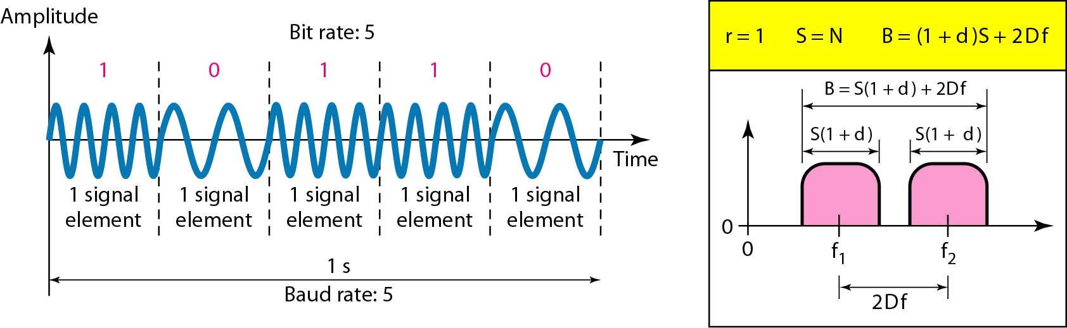
Frequency Shift Keying (FSK)
In frequency shift keying, the frequency of the carrier signal is varied to represent
data. The frequency of the modulated signal is constant for the duration of one signal element, but changes for the next signal element if the data element changes. Both amplitude and phase remain constant for all signal elements.
Carrier signal are simple sine waves, but modulation creates a non periodic composite signal with continuous frequencies. We can say that FSK as two ASK signal with its own carrier frequencies (f1 or f2). The Difference between two frequencies is 2Df then the required bandwidth is B= (1+d)*S + 2Df

Slide 36
Frequency Shift Keying (FSK)
Advantages
The antenna size reduced.
Avoid multiplexing of signals, decrease the SNR.
Long-range communication can be possible.
Disadvantages
It uses larger bandwidth compare to ASK and PSK. Hence it is not bandwidth efficient.
The bit error rate is less in AEGN channel than phase shift keying.

Slide 37
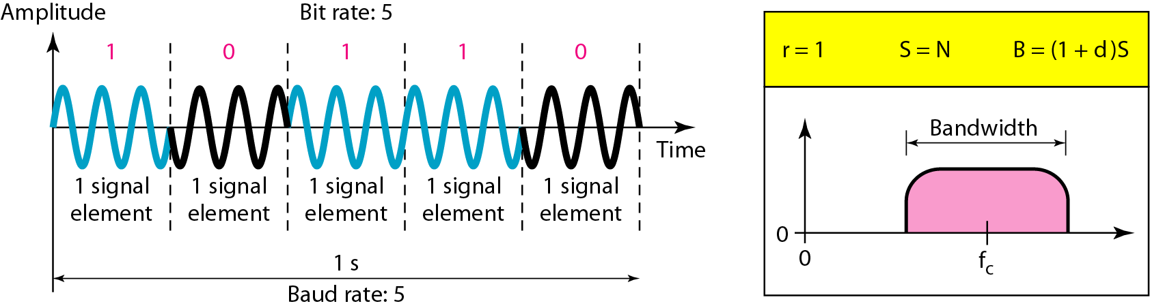
Phase Shift Keying (PSK)
In phase shift keying, the phase of the carrier is varied to represent two or more different signal elements. Both peak amplitude and frequency remain constant as the phase changes.
d = 0 for PSK
Bandwidth is same as that for binary ASK, but less than that for Binary FSK (BFSK). No Bandwidth is wasted for separating two carrier signal

Slide 38
Phase Shift Keying (PSK)
Binary PSK is as simple as binary ASK with one big advantage-it is less susceptible to noise. In ASK, the criterion for bit detection is the amplitude of the signal; in PSK, it is the phase.
Noise can change the amplitude easier than it can change the phase.
In other words, PSK is less susceptible to noise than ASK. PSK is superior to FSK because we do not need two carrier signals.
Advantages
It is more power efficient modulation technique compare to ASK and FSK.
Disadvantages
It has lower bandwidth efficiency.

Slide 39

Quadrature Amplitude Modulation (QAM)
Quadrature amplitude modulation is a combination of ASK and PSK.
QAM uses two carriers, one in-phase and the other quadrature, with different amplitude levels for each carrier.
Bandwidth for QAM
The minimum bandwidth required for QAM transmission is the same as that required for ASK and PSK transmission. QAM has the same advantages as PSK over ASK.
Advantages
Efficient usage of bandwidth
Disadvantages
QAM modulation is more susceptible to the noise
Linear amplifier is needed which consumes more power
Applications
Used in the radio communications
Used in optical fiber systems to increase bit rates

Slide 40
Digital-to-Digital conversion (line coding, block coding, scrambling)

Slide 41
Digital-to-Digital conversion
Digital-to-digital conversion techniques, methods which convert digital data to digital signals.
The conversion involves Three techniques:
Line Coding
Block Coding
Scrambling
Note: Line coding is always needed; block coding and scrambling may or may not be needed.

Slide 42
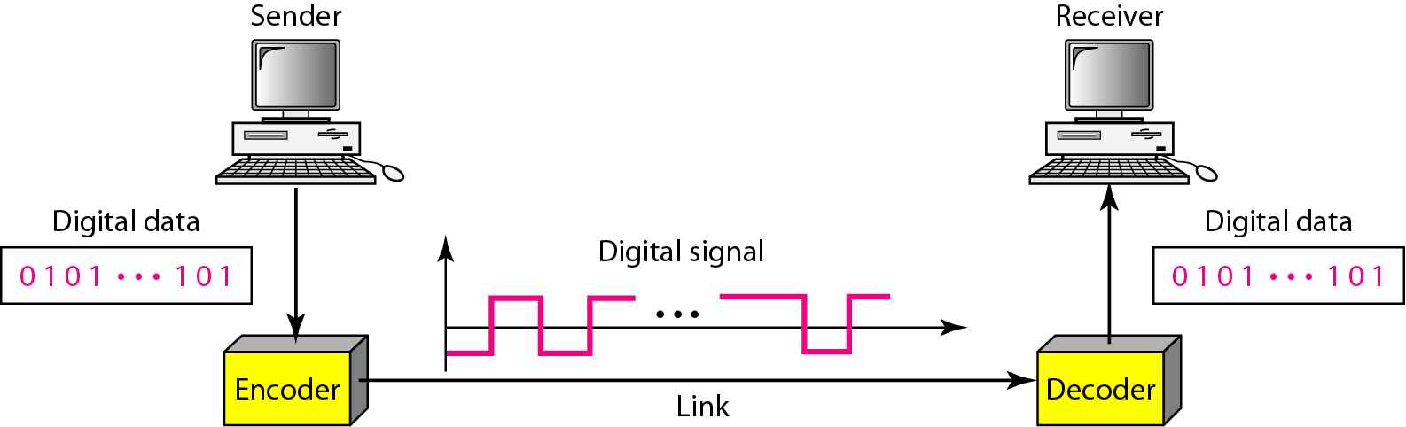
Line Coding
Line coding is the process of converting digital data to digital signals.
At the sender, digital data are encoded into a digital signal; at the receiver, the digital data are recreated by decoding the digital signal.
High voltage level (+V) could represent a “1” and a low voltage level (0 or -V) could represent a “0”.

Slide 43
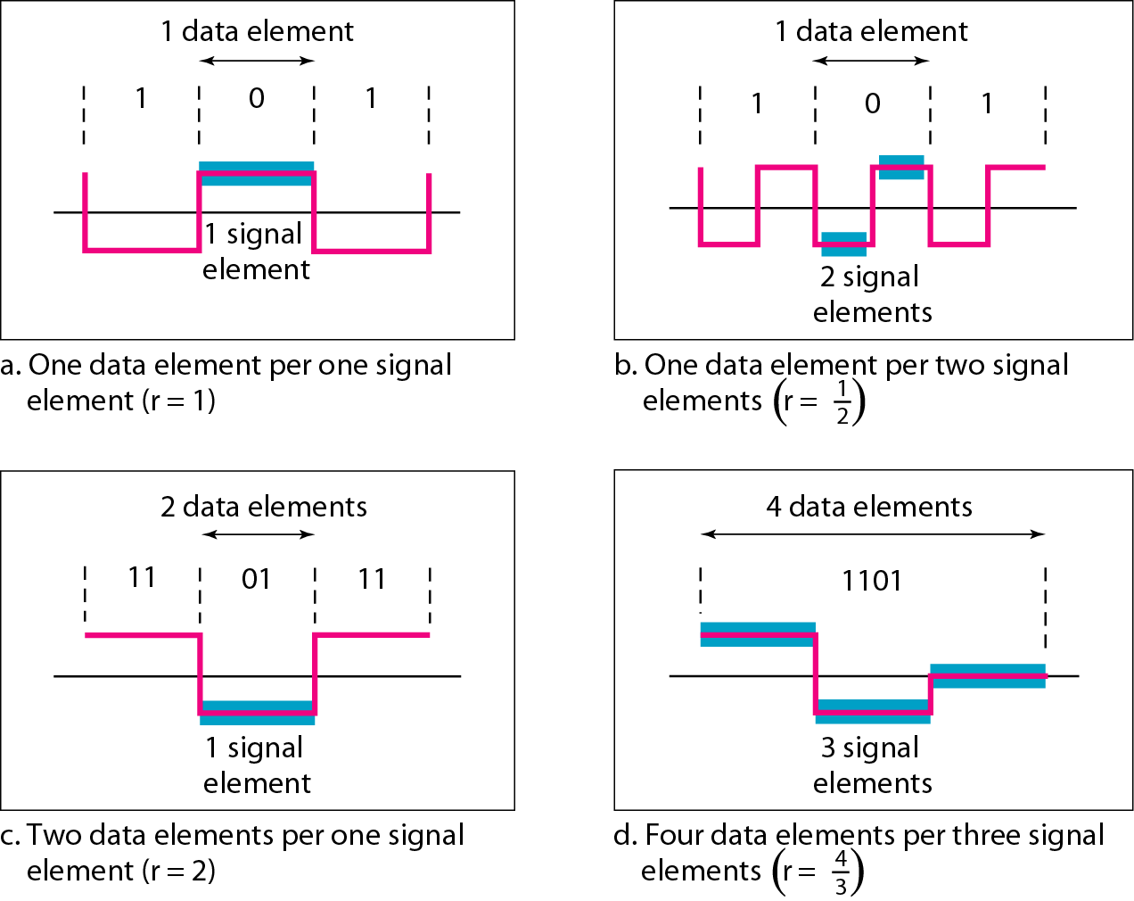
Line Coding
We define a ratio r which is the number of data elements carried by each signal element.
In part a of the figure, one data element is carried by one signal element (r = 1). In
Part b, we need two signal elements (two transitions) to carry each data
element (r = 1/2 ).
In part c, a signal element carries two data elements (r = 2).
In part d, a group of 4 bits is being carried by a group of three signal elements (r =4/3).

Slide 44
Data Rate Versus Signal Rate
The data rate defines the number of data elements (bits) sent in 1s.
The unit is bits per second (bps).
The signal rate is the number of signal elements sent in 1s. The unit is the baud.
There are several common terminologies used in the literature.
The data rate is sometimes called the bit rate; the signal rate is sometimes called the pulse rate, the modulation rate, or the baud rate.
One goal: To increase the data rate while decreasing the signal rate.
Increasing the data rate increases the speed of transmission; decreasing the signal rate decreases the bandwidth requirement.

Slide 45
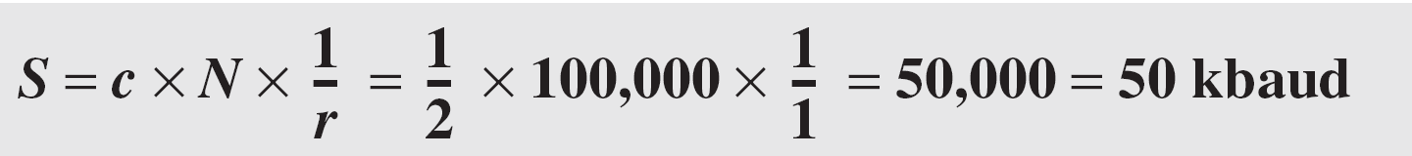
Example 6
A signal is carrying data in which one data element is encoded as one signal element ( r = 1). If the bit rate is 100 kbps, what is the average value of the baud rate if c is between 0 and 1? Assume that the average value of c is 1/2
c is the case factor (worst, best & avg.) =1/2
S = c x N x 1/r bauds
N is data rate =100 kbps=100,000
r is the ratio between data element & signal element = 1/1

Slide 46
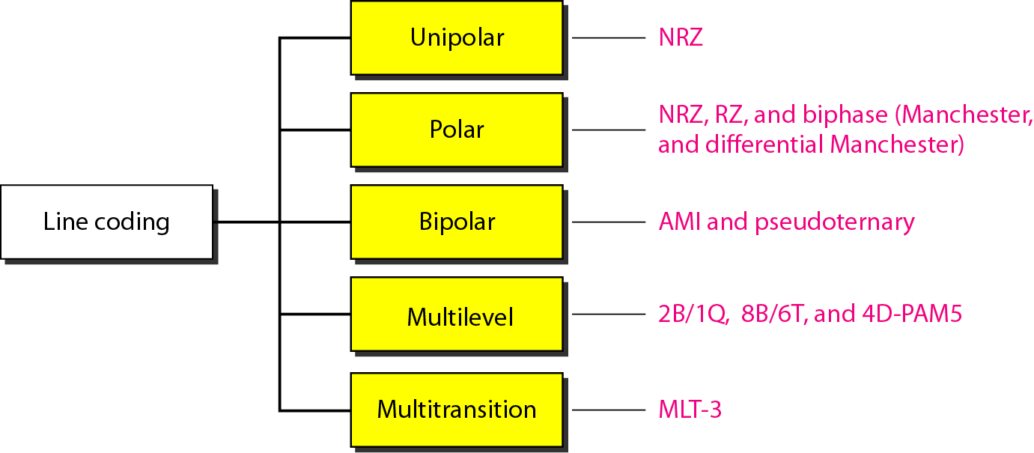
Line Coding Schemes

Slide 47
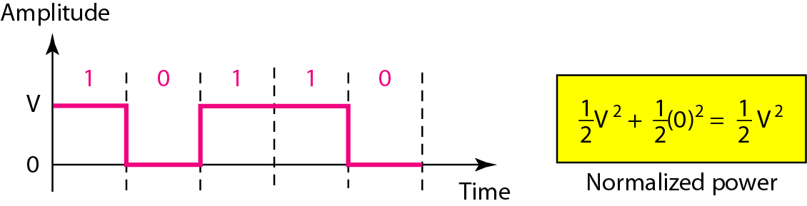
Unipolar NRZ scheme
In a unipolar scheme, all the signal levels are on one side of the time axis, either above or below. In Non-Return-to-Zero, the signal does not return to zero at the middle of the bit, where positive voltage defines bit 1 and the zero voltage defines bit 0.
It is simple but costly in power consumption.
Sequence of bits=10110

Slide 48
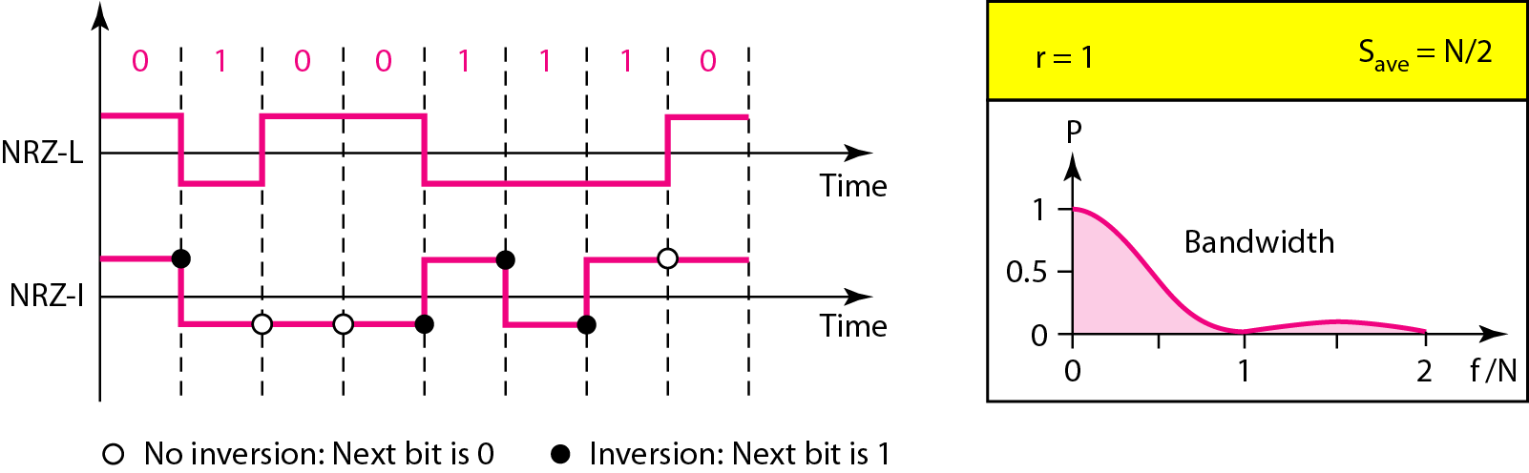
Polar NRZ scheme
a. Non-Return-to-Zero (NRZ):
The voltages are on both sides of the time axis.
Polar NRZ scheme can be implemented with two voltages. E.g. +V for 1 and -V for 0.
There are two versions:
1. NZR - Level (NRZ-L) - positive voltage for zero symbol and negative for the other.
2. NRZ - Inversion (NRZ-I) - the change or lack of change in polarity determines the value of a symbol. E.g. a “1” symbol inverts the polarity a “0” does not.

Slide 49
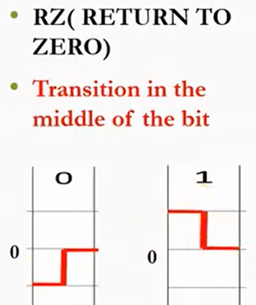
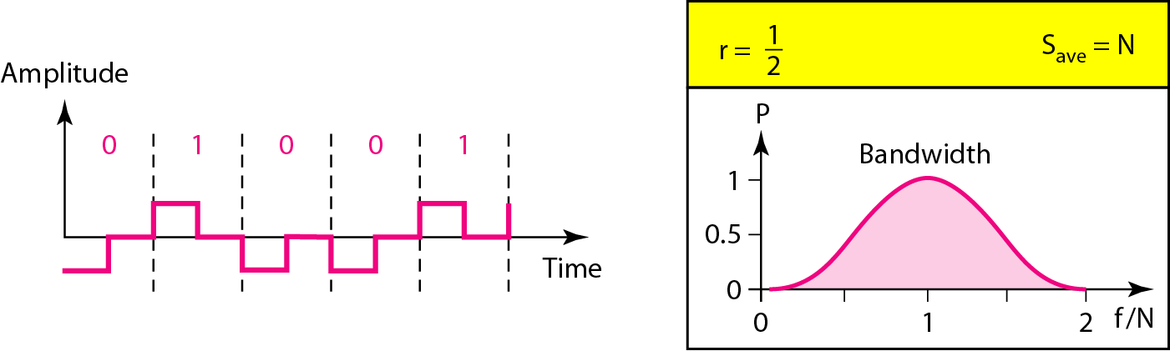
Polar RZ scheme
b. Return-to-Zero (RZ):
This scheme uses three voltage values. +, 0, -.
Each symbol has a transition in the middle. Either from high to zero or from low to zero.
This scheme has more signal transitions (two per symbol), so requires a wider bandwidth.
Problem is the complexity due to 3 signals.
Not in use.

Slide 50
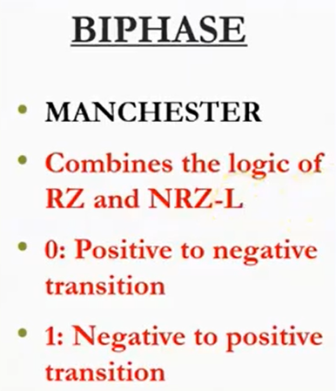
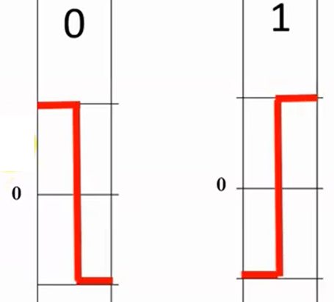
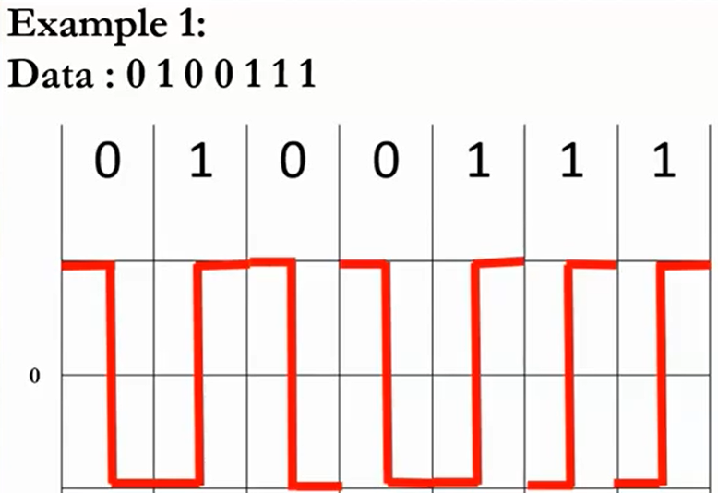
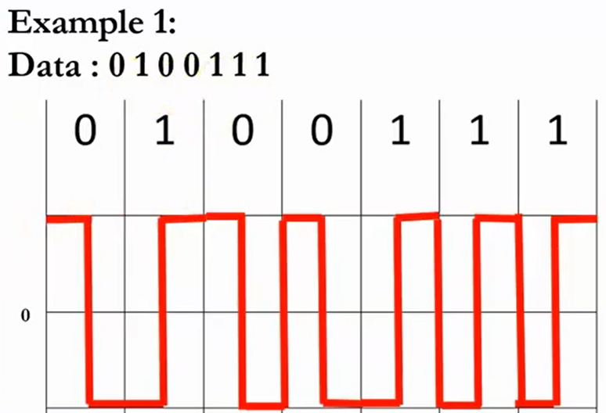
2. Polar Schemes : Manchester

Slide 51

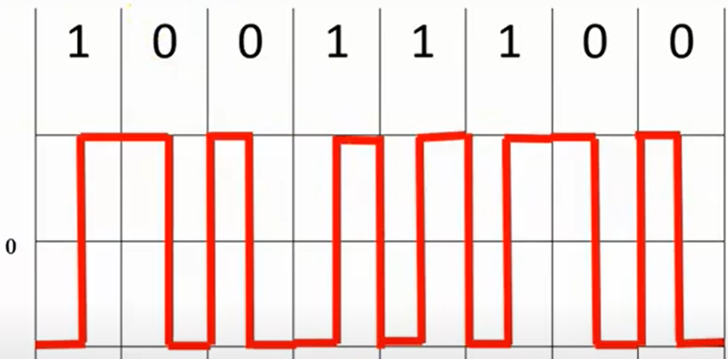
2. Polar Schemes : Manchester

Slide 52
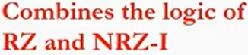
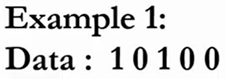
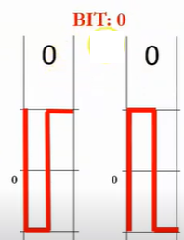
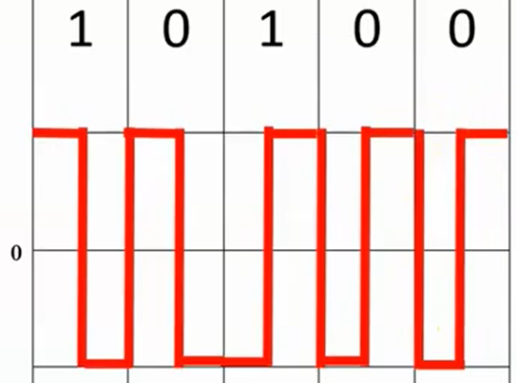
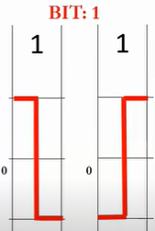
2. Polar Schemes : Differential Manchester

Slide 53
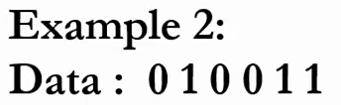
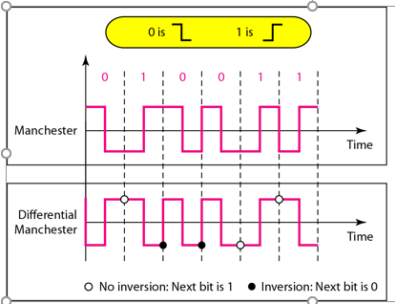
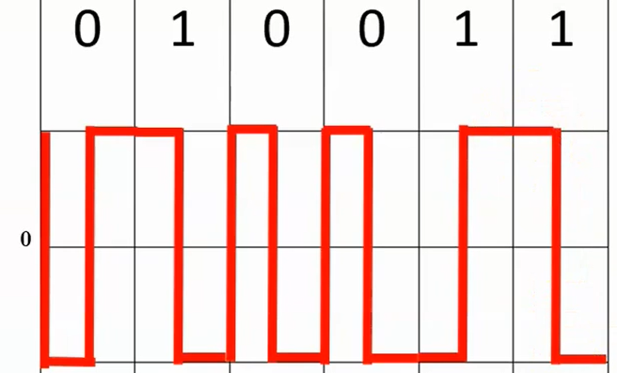
2. Polar Schemes : Differential Manchester

Slide 54
2. Polar Schemes : Differential Manchester
In Manchester and differential Manchester encoding, the transition at the middle of the bit is used for synchronization
The minimum bandwidth of Manchester and differential Manchester is 2 times that of NRZ.

Slide 55
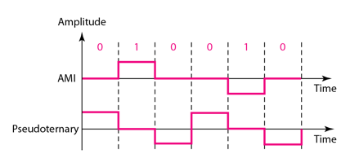
3. Bipolar: Alternate Mark Inversion (AMI) and Pseudoternary
Alternate Mark Inversion (AMI) and Pseudoternary.
Mark means 1. So AMI means alternate 1 inversion.
A neutral zero voltage represents binary 0. Binary 1s are represented by alternating positive and negative voltages.
A variation of AMI encoding is called pseudoternary in which the 1 bit is encoded as a zero voltage and the 0 bit is encoded as alternating positive and negative voltages.
AMI is commonly used for long-distance communication, but it has a synchronization problem when a long sequence of O’s (Zero) is present in the data.

Slide 56
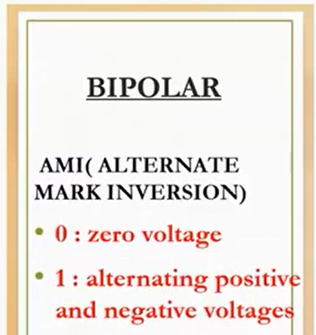
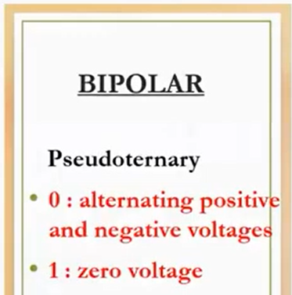
Revision

Slide 57
4. Multilevel Schemes
In mBnL schemes, a pattern of m data elements is encoded as a pattern of n signal elements in which 2^{m} ≤ L^{n}.

Slide 58
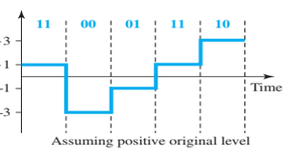
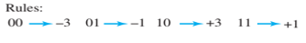
4. Multilevel Schemes
The first mBnL scheme we discuss, two binary, one quaternary (2B1Q), uses data patterns of size 2 and encodes the 2-bit patterns as one signal element belonging to a four-level signal.
In this type of encoding m = 2, n = 1, and L = 4 (quaternary).
2 times faster than by using NRZ-L
There are no redundant signal patterns in this scheme because 2² = 4¹.
Used in DSL (Digital Subscriber Line) technology to provide a high-speed connection to the Internet by using subscriber telephone lines

Slide 59
5. Multitransition: MLT-3
The multiline transmission, three-level (MLT-3) scheme uses three levels (+V, 0, and -V) and three transition rules to move between the levels. 1. If the next bit is 0, there is no transition. 2. If the next bit is 1 and the current level is not 0, the next level is 0. 3. If the next bit is 1 and the current level is 0, the next level is the opposite of the last nonzero level.
The three voltage levels (-V, 0, and +V) are shown by three states (ovals).
It turns out that the shape of the signal in this scheme helps to reduce the required bandwidth.
MLT-3 a suitable choice when we need to send 100 Mbps on a copper wire that cannot support more than 32 MHz.
1 = level change. 0 = no change.

Slide 60
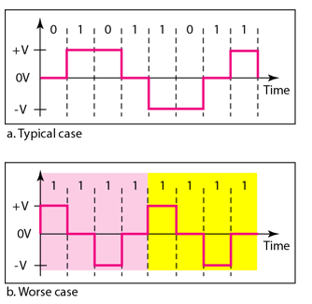
5. Multitransition: MLT-3

Slide 61
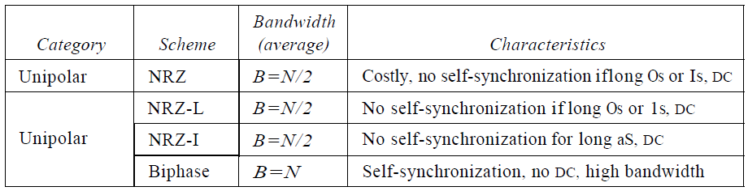
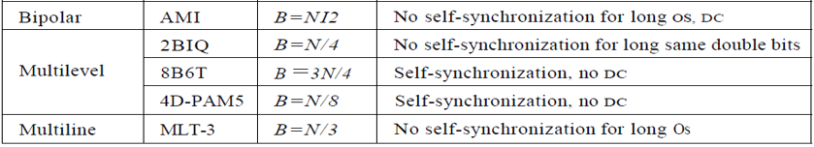
Summary of line coding schemes PN 151

Slide 62
2. Block Coding
We need redundancy to ensure synchronization and to provide some kind of inherent error detecting.
Block coding can give us this redundancy and improve the performance of line coding.
A technique of sending data in a set of sequence.
Block coding is done in three steps:
1. Division
2. Substitution
3. Combination.
Need to add redundant bits for padding, error checking

Slide 63
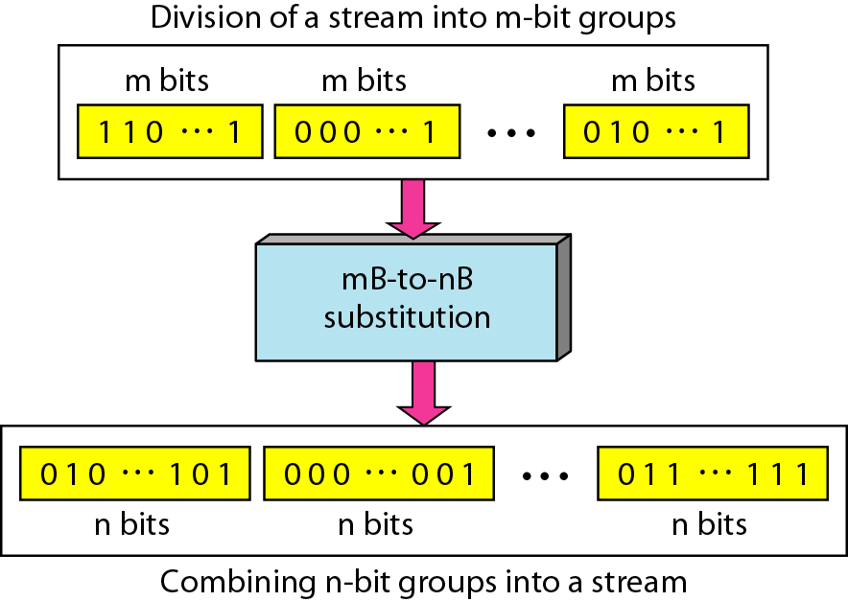
Block Coding
Division (a sequence of bits is divided into groups of m bits)
2. Substitution (substitute an m-bit group for an n-bit group.)
3. Combination (n-bit groups are combined together to form a stream)

Slide 64
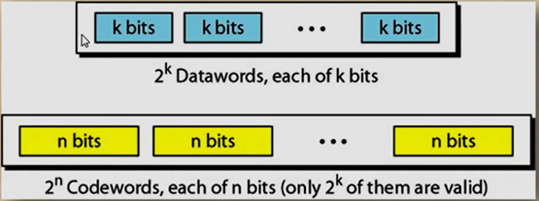
Block Coding

Slide 65

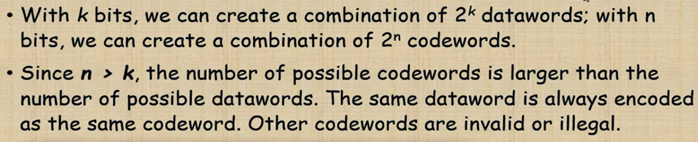
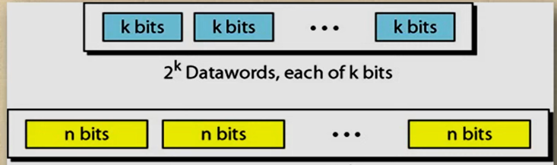

Slide 66

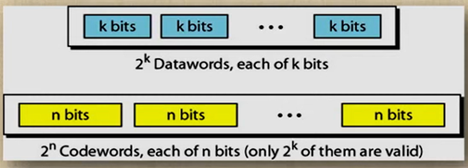
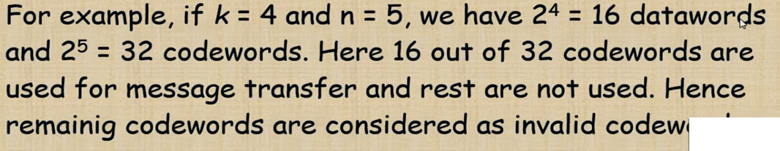
ords

Slide 67
Scrambling
Earlier coding schemes are not suitable for long distance because of DC component.
Scrambling is a technique to avoid long sequence of 0’s used to create a sequence of bits that has the required c/c’s for transmission - self clocking, no low frequencies, no wide bandwidth.
It is implemented at the same time as encoding, the bit stream is created on the fly.
It replaces ‘unfriendly’ runs of bits with a violation code that is easy to recognize and removes the unfriendly c/c.

Slide 68





Scrambling cont- https://www.youtube.com/watch?v=DtfUPa7RG9s
a.
The V in the sequence denotes violation, this is a nonzero voltage that breaks an AMI rule of encoding (opposite polarity from the previous).
The B in the sequence denotes bipolar, which means a nonzero level voltage in accordance with the AMI rule.

Slide 69



Scrambling cont-
a.

Slide 70



Scrambling
a.

Slide 71




Scrambling cont-
b.
High-Density Bipolar 3 -zero

Slide 72


Scrambling cont-
b.

Slide 73

Scrambling

Slide 74
Analog-to-Digital Conversion

Slide 75
Analog-to-Digital Conversion
A digital signal is superior to an analog signal.
It is more robust to noise and can easily be recovered, corrected and amplified. For this reason, it is better to change an analog signal to digital data.
Analog-to-Digital Conversion: Two techniques
1. Pulse Code Modulation (PCM) and
2. Delta Modulation(DM)

Slide 76

Components of PCM encoder
_{Pulse Code Modulation.}
_{Analog} to digital conversion. Digitization.
1. The analog signal is sampled. 2. The sampled signal is quantized. 3. The quantized values are encoded as streams of bits.

Slide 77



Three different sampling methods for PCM - Pulse Code Modulation, PAM – Pulse Amplitude Modulation = Sampling
According to the Nyquist theorem, the sampling rate must be at least 2 times the highest frequency contained in the signal.+
Analog signal is sampled every TS secs. where Ts is the sample interval or period. The inverse of the sampling interval is called the sampling rate or sampling frequency.
_{There are 3 sampling methods:}
1. Ideal - pulses from the analog signal are sampled. This is an ideal sampling method and cannot be easily implemented.
2. Natural - a pulse of short width with varying amplitude. A high-speed switch is turned on for only the small period of time when the sampling occurs. The result is a sequence of samples that retains the shape of the analog signal.
3. Flattop - The most common sampling method, called sample and hold, however, creates flat-top samples by using a circuit.

Slide 78

Example 7 Recovery of a sampled sine wave for different sampling rates
For an example of the Nyquist theorem, let us sample a simple sine wave at three sampling rates: f_{s} = 4f (2 times the Nyquist rate), f_{s} = 2f (Nyquist rate), and f_{s} = f (one-half the Nyquist rate). Figure 4.24 shows the sampling and the subsequent recovery of the signal.
It can be seen that sampling at the Nyquist rate can create a good approximation of the original sine wave (part a). Oversampling in part b can also create the same approximation, but it is redundant and unnecessary. Sampling below the Nyquist rate (part c) does not produce a signal that looks like the original sine wave.

Slide 79
Example 7 Recovery of a sampled sine wave for different sampling rates
For an example of the Nyquist theorem, let us sample a simple sine wave at three sampling rates: f_{s} = 4f (2 times the Nyquist rate), f_{s} = 2f (Nyquist rate), and f_{s} = f (one-half the Nyquist rate). Figure 4.24 shows the sampling and the subsequent recovery of the signal.
It can be seen that sampling at the Nyquist rate can create a good approximation of the original sine wave (part a). Oversampling in part b can also create the same approximation, but it is redundant and unnecessary. Sampling below the Nyquist rate (part c) does not produce a signal that looks like the original sine wave.

Slide 80

Binary Encoding

Slide 81
Quantization Steps
Assume we have a voltage signal with amplitudes V_{min}=-20V and V_{max}=+20V.
We want to use L=8 quantization levels.
Zone width Δ = (20 - -20)/8 = 5
The 8 zones are: -20 to -15, -15 to -10, -10 to -5, -5 to 0, 0 to +5, +5 to +10, +10 to +15, +15 to +20
The midpoints are: -17.5, -12.5, -7.5, -2.5, 2.5, 7.5, 12.5, 17.5

Slide 82
Binary Encoding
Each zone is then assigned a binary code.
The number of bits required to encode the zones, or the number of bits per sample as it is commonly referred to, is obtained as follows:
n_{b} = log₂ L
Given our example, n_{b} = 3
The 8 zone (or level) codes are therefore: 000, 001, 010, 011, 100, 101, 110, and 111
Assigning codes to zones:
000 will refer to zone -20 to -15
001 to zone -15 to -10, etc.

Slide 83



PCM
Advantages
Disavantages
Applications

Slide 84

Example 8
We want to digitize the human voice. What is the bit rate, assuming 8 bits per sample?
Solution
The human voice normally contains frequencies from 0 to 4000 Hz. So the sampling rate and bit rate are calculated as follows:

Slide 85

Delta Modulator
PCM is a very complex technique. Other techniques have been developed to reduce the complexity of PCM.
The simplest is delta modulation.
PCM finds the value of the signal amplitude for each sample; DM finds the change from the previous sample.
Note that there are no code words here; bits are sent one after another.
Figure The process of delta modulation

Slide 86

Delta modulation components
Modulator: is used at the sender site to create a stream of bits from an analog signal.
If the delta is positive, the process records a 1; if it is negative, the process records a 0.
Base of comparison is required. Which is done by Staircase Maker.
The modulator, at each sampling interval, compares the value of the analog signal with the last value of the staircase signal.
Note that we need a delay unit to hold the staircase function for a period between two comparisons.

Slide 87

Delta demodulation components
Demodulator: The demodulator takes the digital data and, using the staircase maker and the delay unit, creates the analog signal.
Low-pass filter is used for smoothing.
Adaptive DM: A better performance can be achieved if the value of δ is not fixed. In adaptive delta modulation, the value of δ changes according to the amplitude of the analog signal.
Quantization Error: DM is not perfect. Quantization error is always introduced in the process. The quantization error of DM, however, is much less than that for PCM.

Slide 88
Types of Networks

Slide 89

Computer Networks
Autonomous computers are network or a collection of networks that are all managed and supervised by a single entity or organization
Two or more autonomous computers are connected
Geographic location: anywhere

Slide 90

Types of Networks
Classification of interconnected processors:
Personal area networks (PAN)
Local area networks (LAN)
Metropolitan area networks (MAN)
Wide are networks (WAN)
Ad-hoc network

Slide 91

Personal Area Network (PAN)

Slide 92

Local Area Network (LAN)
Wireless and Wired LAN
(a) 802.11 (b) Switched Ethernet

Slide 93

Metropolitan Area Network(MAN): based on cable TV

Slide 94

Wide Area Network (WAN)
WAN: connects three branch offices in Australia

Slide 95

Ad-hoc Network

Slide 96
Comparision of LAN, MAN, WAN
Sr.No. | Key | LAN | MAN | WAN
1 | Definition | LAN stands for Local Area Network. | MAN stands for Metropolitan Area Network. | WAN stands for Wide Area Network.
2 | Ownership | LAN is often owned by private organizations. | MAN ownership can be private or public. | WAN ownership can be private or public.
3 | Speed | LAN speed is quiet high. | MAN speed is average. | WAN speed is lower than that of LAN.
4 | Delay | Network Propagation Delay is short in LAN. | Network Propagation Delay is moderate in MAN. | Network Propagation Delay is longer in WAN.
5 | Congestion | LAN has low congestion as compared to WAN. | MAN has higher congestion than LAN. | WAN has higher congestion than both MAN and LAN.
6 | Fault Tolerance | Fault Tolerance of LAN is higher than WAN. | Fault Tolerance of MAN is lower than LAN. | Fault Tolerance of WAN is lower than both LAN and MAN.
7 | Maintenance | Designing and maintaining LAN is easy and less costly than WAN. | Designing and maintaining WAN is complex and more costly than LAN. | Designing and maintaining WAN is complex and more costly than both LAN and MAN.

Slide 97


Uses of Computer Networks
Business Applications Home Applications: P2P having no fixed clients & servers
Business Applications

Slide 98

Uses of Computer Networks
Mobile Users: Combinations of wireless networks and mobile computing
Social Issues
Network neutrality
Digital Millennium Copyright Act
Profiling users
Phishing

Slide 99
Network Architectures

Slide 100
Network Architectures
Client-Server
Peer-to-Peer
Distributed Network
Software Define Network

Slide 101

Client-Server Model
Client-server model: involves requests and replies

Slide 102

Peer-to-Peer Architecture
All nodes acts as a clients and servers
- Provides and consume data
-Any node can initiate a connection
No centralized data source
-The ultimate form of democracy on the Internet
-The ultimate threat to copy-right protection on
the Internet

Slide 103

Distributed Network
Distributed networks are part of distributed computing architecture, in which enterprise IT infrastructure resources are divided over a number of networks, processors and intermediary devices

Slide 104

Software Define Network
Software-Defined Networking (SDN) is dynamic, manageable, cost-effective, and adaptable for the high-bandwidth, dynamic nature of today’s applications
This architecture decouples the network control and forwarding functions enabling the network control to become directly programmable and the underlying infrastructure to be abstracted for applications and network services

Slide 105
Network Topologies

Slide 106

Network Topologies
Way of connection between computers, printers and other devices
Layout of the wire and devices as well as the paths used by data transmissions

Slide 107

Bus Topology
Commonly referred as a linear bus
All the devices are connected by one single cable
Advantages
It is easy to set up, handle, and implement.
It is best-suited for small networks.
It costs very less.
Disadvantages
The cable length is limited - limits the number of network nodes
When the number of devices connected to the bus increases, the efficiency decreases.
A fault in the central bus leads to network failure.
Each device on the network “sees” all the data being transmitted.

Slide 108

Star Topology
Star topology
most commonly used architecture in Ethernet LANs
resembles spokes in a bicycle wheel
Advantages of Star Topology
Due to its centralized nature, the topology offers simplicity of operation.
It also achieves isolation of each device in the network.
Adding or removing network nodes is easy.
Due to the centralized nature, it is easy to detect faults in the network devices.
Disadvantages of Star Topology
Network operation depends on the functioning of the central hub. Hence, central hub failure leads to failure of the entire network.
Also, the number of nodes that can be added, depends on the capacity of the central hub.
The setup cost is quite high.

Slide 109

Tree Topology
Extended star topology or tree topology
significantly reduces the traffic on the wires by sending packets only to the wires of the destination host
network devices that filter frames or packets like bridges, switches and routers
Advantages of Tree Topology
The tree topology is useful in cases where a star or bus cannot be implemented individually.
Fault identification is easy.
The network can be expanded by the addition of secondary nodes. Thus, scalability is achieved.
Disadvantages of Tree Topology
As multiple segments are connected to a central bus, the network depends heavily on the bus. Its failure affects the entire network
Owing to its size and complexity, maintenance is not easy and costs are high
Though it is scalable, the number of nodes that can be added depends on the capacity of the central bus and on the cable type.

Slide 110


Ring Topology
A frame travels around the ring, stopping at each node
A Node wants to transmit data it adds the data as well as the destination address to the frame, which takes the data out of the frame
Single ring – all the devices on the network share a single cable
Dual ring – allows data to be sent in both directions
Advantages of Ring Topology
A central server is not required
The traffic is unidirectional and the data transmission is high-speed
In comparison to a bus, a ring is better at handling load.
The adding or removing of network nodes is easy.
It is less costly than a star topology.
Disadvantages of Ring Topology
The failure of a single node in the network can cause the entire network to fail
The movement made to network nodes affect the entire network’s performance.

Slide 111

Mesh Topology
Connects all devices (nodes) to each other for redundancy and fault tolerance
Used in WANs to interconnect LANs and for mission critical networks like those used by banks and financial institutions
Implementation is Expensive and difficult
Advantages of Mesh Topology
Possible to transmit data from one node to many other nodes at the same time.
The failure of a single node does not cause the entire network to fail
It can handle heavy traffic
Easy to identify faults.
Disadvantages of Mesh Topology
A lot of cabling is required.
Costly setup and maintenance
Administration of a mesh network is difficult

Slide 112
Comparison of network Topologies
Topology | Information Transfer | Setup | Expansion | Troubleshooting | Cost | Cabling Concerns
Star Each computer connects to a central connection device. | All information passes through the central network connection. | Each computer must be close to the central device. 100 meters maximum cable length. Up to 24 computers per network. | Add a new computer by plugging in a new cable from the computer to the connection device. | When one computer goes down, the rest of the network is unaffected. If the connection device goes down, then the network is down. | More expensive of the simple topologies, it requires costly connection device. Usually cheaper than a hybrid network. | Uses twisted pair cable. Requires large amounts of cable. No more than 100 meters from the computer to the connection device.
Bus Single cable connects everything. | One computer at a time sends information. Information goes along the cable and the computer accesses the information off the cable. | Connect the cable from one computer to the next and so on to the end. A terminator is placed at each end of the network. | To add a computer, you must shut down the network and disconnect the cable from the existing computers. | If one computer malfunctions, the entire network goes down. | A cheaper network since there is usually one continuous copper cable. | Single continuous cable connects the devices. Terminator is required at each end of the cable. Uses coaxial or twisted pair cabling.

Slide 113
Comparison of network Topologies
Ring Single cable configured in a ring. | Information goes in one direction around the ring and passes along the ring until it reaches the correct computer. | Computers are located close to each other. Setup is easy. There is no connector. The ring has no beginning and no end. | Cable between the computers must be broken to add a new computer, so the network is down until the new device is back online. | If there's a break in the cable or an error in the network, information continues to transfer through the rest of the ring until reaching the point of the break. This makes troubleshooting easy. | One of the more expensive topologies due to high cable costs. | Requires more cabling than other topologies. Uses twisted pair.
Hybrid Mesh Combines two or more different structures. | Often used across long distances. Information transfer can happen in different ways, depending on the other topologies. | Often created when expanding an existing network. Can use a variety of connection devices. | Connection devices make combining different networks and different topologies easy. | Troubleshooting is most difficult in this topology because of the variety of technologies. | Expensive, large, and usually complicated. | Cabling depends on the types of networks. Can use twisted pair and coaxial cable. Also incorporates fiber optic cabling over long distances.

Slide 114
Transmission media’s

Slide 115

Transmission Media
Transmission media is a communication channel that carries the information from the sender to the receiver.
Transmission media is of two types are wired media and wireless media.
Different transmission media have different properties such as bandwidth, delay, cost and ease of installation and maintenance.
Transmission media are located below the physical layer
Transmission medium and physical layer

Slide 116

Classification of Transmission Media

Slide 117

Twisted-pair cable
A twisted pair consists of two conductors basically copper based with its own plastic insulation, twisted together.
One of the wires is used to carry signals to the receiver, and the other is used only as a ground reference. The receiver uses the difference between the two.

Slide 118


Twisted-pair cable
UTP cable
STP cable
The most common twisted-pair cable used in communications is referred to as unshielded twisted-pair (UTP). IBM has also produced a version of twisted-pair cable for its use called shielded twisted-pair (STP). STP cable has a metal foil or braided mesh covering that encases each pair of insulated conductors. Although metal casing improves the quality of cable by preventing the penetration of noise or crosstalk, it is bulkier and more expensive.

Slide 119
Twisted-pair cable
UTP cable
STP cable
Advantages Of Unshielded Twisted Pair:
It is cheap.
Installation of the unshielded twisted pair is easy.
It can be used for high-speed LAN.
Disadvantage:
This cable can only be used for shorter distances because of attenuation..
Characteristics Of Shielded Twisted Pair:
An installation of STP is easy.
It has higher capacity as compared to unshielded twisted pair cable.
It is shielded that provides the higher data transmission rate.
Disadvantages
It is more expensive as compared to UTP
It has a higher attenuation rate.

Slide 120

Categories of unshielded twisted-pair cables

Slide 121

Coaxial Cable
Coaxial cable (Coax) is very commonly used for example, TV wire is usually a coaxial cable.
Coaxial - contains two conductors parallel to each other.
It has a higher frequency as compared to Twisted pair cable.
The inner conductor of the coaxial cable is made up of copper, and the outer conductor is made up of copper mesh.
Advantages Of Coaxial cable:
The data can be transmitted at high speed.
It has better shielding as compared to twisted pair cable.
It provides higher bandwidth.
Applications
was widely used in analog telephone networks
Cable TV networks
Can carry 10,000 voice signals.
Traditional Ethernet LANs
Disadvantages of Coaxial cable:
It is more expensive as compared to twisted pair cable.
If any fault occurs in the cable causes the failure in the entire network.

Slide 122

Fiber-Optic Cable
Fibre optic cable is a cable that uses electrical signals for communication.
Fibre optic is a cable that holds the optical fibres coated in plastic that are used to send the data by pulses of light.
The plastic coating protects the optical fibres from heat, cold, electromagnetic interference from other types of wiring.
Fibre optics provide faster data transmission than copper wires.

Slide 123
Fiber-Optic Cable
Advantages of Fiber-optic cable
Higher bandwidth: The fiber optic cable provides more bandwidth as compared copper.
Fiber optic cable carries the data in the form of light. This allows the fibre optic cable to carry the signals at a higher speed.
Less signal attenuation: Fiber-optic transmission distance is significantly greater than that of other guided media.
Immunity to electromagnetic interference: Electromagnetic noise cannot affect fiber-optic cables.
Resistance to corrosive materials: Glass is more resistant to corrosive materials than copper.
Light weight: Fiber-optic cables are much lighter than copper cables.
Greater immunity to tapping: Fiber-optic cables are more immune to tapping than copper cables.
Disadvantages of Fiber-optic cable
Installation and maintenance: Its installation and maintenance require expertise that is not yet available everywhere.
Unidirectional light propagation: Propagation of light is unidirectional.
Cost: The cable and the interfaces are relatively more expensive than those of other guided media.

Slide 124

UNGUIDED MEDIA: WIRELESS
An unguided transmission transmits the electromagnetic waves without using any physical medium. Therefore it is also known as wireless transmission.
Figure shows the part of the electromagnetic spectrum, ranging from 3 kHz to 900 THz, used for wireless communication.
Electromagnetic spectrum for wireless communication

Slide 125

UNGUIDED MEDIA: WIRELESS
Unguided signals can travel from the source to destination in several ways: ground propagation, sky propagation, and line-of-sight propagation
In ground propagation, radio waves travel through the lowest portion of the atmosphere, touching the earth.
In sky propagation, higher-frequency radio waves radiate upward into the ionosphere where they are reflected back to earth.
In line-of-sight propagation, very high-frequency signals are transmitted in straight lines directly from
antenna to antenna
Electromagnetic spectrumfor wireless communication

Slide 126

UNGUIDED MEDIA: WIRELESS
Radio Waves
Radio waves are the electromagnetic waves that are transmitted in all the directions of free space.
Radio waves are omnidirectional, i.e., the signals are propagated in all the directions.
Electromagnetic waves ranging in frequencies between 3Khz to 1 Ghz are called radio waves
Applications Of Radio waves:
Radio waves are used for multicast communications, such as radio and television, and paging systems.

Slide 127
Microwaves
Electromagnetic waves having frequencies between 1 and 300 GHz are called microwaves.
Microwaves are unidirectional. When an antenna transmits microwave waves, they can be narrowly focused. This means that the sending and receiving antennas need to be aligned.
The unidirectional property has an obvious advantage. A pair of antennas can be aligned without interfering with another pair of aligned antennas.
Applications:
Microwaves are used for unicast communication such as cellular telephones, satellite networks, and wireless LANs

Slide 128
Infrared
Frequencies from 300 GHz to 400 THz
Used for short-range communication
Applications:
Infrared waves are used for short-range communications such as those between a PC and a peripheral device.
TV remote operation
They can also be used for indoor LANs.

Slide 129
Networking Devices

Slide 130

Networking Devices
Networking devices are Repeaters, Hubs, Bridges, Switches, Routers and Gateways
Repeater:
A repeater operates at the physical layer.
A repeater receives a signal and, before it becomes too weak or corrupted, regenerates the original bit pattern.
A repeater is a regenerator, not an amplifier.
Hub:
Hub is used to connect devices to the same network.
Hubs cannot filter data, so data packets are sent to all
connected devices

Slide 131
Networking Devices
Bridge
A bridge operates at data link layer
It is also used for interconnecting two LANs working on the same protocol.
Switch
A switch is a data link layer device
It is an intelligent network device that can be conceived as a multiport network bridge.
It uses MAC addresses to send data packets to selected destination ports
Switches can perform some error checking before forwarding data
Router
Routers operate at the Network Layer (Layer 3)
Interconnect IP networks
Gateway:
A gateway is simply a device or hardware that acts as a "gate" between the networks. We can also define it as a node that acts as an entry for other network nodes

Slide 132

Networking Devices
(a) Hub (b) Bridge (c) Switch

Slide 133

Layer wise Networking Devices
(a) Layer wise devices (b) Frames, packets and headers

Slide 134
Comparison of network devices
HUB | SWITCH | ROUTER
Hub is a broadcast device. | The switch is a multicast device. | The router is a routing device.
Hub works in the physical layer of OSI model. | The switch works in data link layer. | The router works in the network layer of OSI model.
Hub is used to connect devices to the same network. | The switch is used to connect devices to the network. | The router is used to connect two different networks.
Hub sends data in the form of bits. | The switch sends data in the form of frames. | The router sends data in the form of packets.
Hub works in half duplex. | The switch works in full duplex. | The router works in full duplex.
Only one device can send data at a time. | Multiple devices can send data at a time. | Multiple devices can send data at a time.
Hub does not store any MAC address of a node in the network. | It uses MAC addresses | It uses IP Addresses

Slide 135
OSI Reference and TCP/IP Model

Slide 136
OSI Reference Model
Principles for the seven layers of OSI Model:
Layers created for different abstractions
Each layer performs well-defined function
Function of layer chosen with definition of international standard protocols in mind
Minimize information flow across interfaces between boundaries
Number of layers optimum

Slide 137

OSI Reference Model
Application layer
Presentation layer
Session layer
Transport layer
Network layer
Data link layer
Physical layer

Slide 138

Summery of duties for each layer of OSI Model

Slide 139

TCP/IP Model

Slide 140

TCP/IP Model: Protocols

Slide 141

TCP/IP and OSI model

Slide 142
Comparison of OSI & TCP/IP Reference Models
OSI(Open System Interconnection) | TCP/IP(Transmission Control Protocol / Internet Protocol)
1. OSI is a generic, protocol independent standard, acting as a communication gateway between the network and end user. | 1. TCP/IP model is based on standard protocols around which the Internet has developed. It is a communication protocol, which allows connection of hosts over a network.
2. In OSI model the transport layer guarantees the delivery of packets. | 2. In TCP/IP model the transport layer does not guarantees delivery of packets. Still the TCP/IP model is more reliable.
3. Follows vertical approach. | 3. Follows horizontal approach.
4. OSI model has a separate Presentation layer and Session layer. | 4. TCP/IP does not have a separate Presentation layer or Session layer.
5. Transport Layer is Connection Oriented. | 5. Transport Layer is both Connection Oriented and Connection less.

Slide 143
OSI(Open System Interconnection) | TCP/IP(Transmission Control Protocol / Internet Protocol)
6. Network Layer is both Connection Oriented and Connection less. | 6. Network Layer is Connection less.
7. OSI is a reference model around which the networks are built. Generally it is used as a guidance tool. | 7. TCP/IP model is, in a way implementation of the OSI model.
8. Network layer of OSI model provides both connection oriented and connectionless service. | 8. The Network layer in TCP/IP model provides connectionless service.
9. OSI model has a problem of fitting the protocols into the model. | 9. TCP/IP model does not fit any protocol
10. Protocols are hidden in OSI model and are easily replaced as the technology changes. | 10. In TCP/IP replacing protocol is not easy.
11. OSI model defines services, interfaces and protocols very clearly and makes clear distinction between them. It is protocol independent. | 11. In TCP/IP, services, interfaces and protocols are not clearly separated. It is also protocol dependent.
12. It has 7 layers | 12. It has 4 layers
Comparison of OSI & TCP/IP Reference Models

Slide 144
Ethernet Standards

Slide 145
Ethernet Standards
Ethernet: It is a LAN protocol that is used in Bus and Star topologies and implements CSMA/CD as the medium access method
Original (traditional) Ethernet developed in 1980 by three companies: Digital, Intel, Xerox (DIX).
In 1985, the Computer Society of the IEEE started a project, called Project 802, to set standards to enable intercommunication among equipment from a variety of manufacturers. Current version is called IEEE Ethernet

Slide 146

802.3 MAC frame

Slide 147

Ethernet address
Six bytes = 48 bits
Flat address not hierarchical
Burned into the NIC ROM
First three bytes from left specify the vendor. Cisco 00-00-0C, 3Com 02-60-8C and the last 24 bit should be created uniquely by the company
Destination Address can be:
Unicast: second digit from left is even (one recipient)
Multicast: Second digit from left is odd (group of stations to receive the frame – conferencing applications)
Broadcast (ALL ones) (all stations receive the frame)
Source address is always Unicast

Slide 148

Ethernet evolution through four generations

Slide 149


Categories of traditional Ethernet
<data rate><Signaling method><Max segment length or cable type>

Slide 150
IEEE 802.3 Cable Types
Name | Cable Max. | Max Cable Segment Length | Nodes /segment
10Base5 | thick coax | 500 meters | 100
10Base2 | thin coax | 185 meters | 30
10BaseT | twisted pair | 100 meters | 1
10BaseF | Fiber Optic | 2Km | 1
Toplogy
Bus
Bus
Star
Star

Slide 151

10Base5 implementation

Slide 152

10Base-T implementation

Slide 153

10Base-F implementation

Slide 154

Fast Ethernet
1. Upgrade the data rate to 100 Mbps.
2. Make it compatible with Standard Ethernet.
3. Keep the same 48-bit address.
4. Keep the same frame format
media: twisted pair (CAT 5) or fiber optic cable (no coax)
Star-wire topology
Similar to 10BASE-T
CAT 3
CAT 5

Slide 155

Fast Ethernet topology

Slide 156

Fast Ethernet implementations

Slide 157

Gigabit Ethernet
1. Upgrade the data rate to 1 Gbps.
2. Make it compatible with Standard or Fast Ethernet.
3. Use the same 48-bit address.
4. Use the same frame format.
5. Keep the same minimum and maximum frame lengths.
6. Support autonegotiation as defined in Fast
EthernetOperates in full/half duplex modes mostly full duplex

Slide 158

Topologies of Gigabit Ethernet

Slide 159

Gigabit Ethernet implementations

Slide 160
Sample Questions
What is the difference between analog and digital signal?
An analog signal has a bit rate of 8000 bps and a baud rate of 1000 baud. How many data elements are carried by each signal element? How many signal elements do we need?
Explain AM, FM and PM with advantages and disadvantages.
Compare AM and FM, Bit rate and Baud rate.
Explain ASK, FSK and PSK with advantages and disadvantages.
Explain Line coding schemes with examples.
Explain PCM with its advantages and disadvantages.
List and explain types of networks along with its advantages.
Explain in detail star and bus topologies with advantages and disadvantages.
Explain point-to-point and broadcast network with examples.
Differentiate LAN, MAN and WAN
Compare Guided and unguided media. What are advantages of Fiber optic cable.
Write a short note on wireless media
What is the difference between Hub, Switch, and Router?
Explain TCP/IP Model with neat diagram,
Explain various types of networks based on their sizes?
Name the different types of network topologies and brief their advantages?
What are the Advantages of Fiber Optics?
Compare OSI Model and TCP/IP model
Explaing Frame format. Write a note on classification of ethernet evolution.

Slide 161
Thank You
Any Questions

